Slide 1


Application of Prim’s algorithm to find the Minimum Spanning Tree. Session No.: Course Name: DAA Course Code: R1UC404B Instructor Name: Pradeep Chauhan Duration: 50 minutes Date of Conduction of Class:

Slide 2
Session Outline
1. | Recap
2. | Opening Activity
3. | Learning Outcomes
4. | Concept and Definition
5. | Activity One
6. | Activity Two
7. | Conclusion
8. | Post Session Activity
9. | Information about next lesson
10. | Review and Reflection from Students

Slide 3
What is Kruskal’s algorithm?

Slide 4
At the end of this session students will beS Students will be able to:
Apply Prim’s algorithm to find the Minimum Spanning Tree

Slide 5
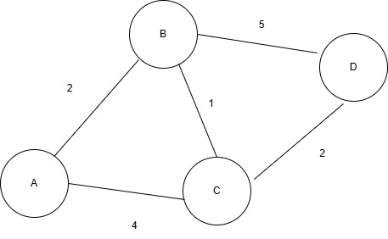
Concept and Definition: Select Min Key vertex u(temp) and do for each adjacent vertex v of u. If key(v)> E(u,v) then key(v)=E(u,b) and par(v)=u else no change
Selected Node-→ |  |  | A | B | C | D
Node | Key Par | Key Par | Key Par | Key Par | Key Par | Key Par
A | ∞ Nil | 0 Nil | 0 Nil | 0 Nil | 0 Nil | 0 Nil
B | ∞ Nil | ∞ Nil | 2 A | 2 A | 2 A | 2 A
C | ∞ Nil | ∞ Nil | 4 A | 1 B | 1 B | 1 B
D | ∞ Nil | ∞ Nil | ∞ Nil | 5 B | 2 C | 2 C

Slide 6

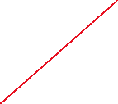



Slide 7
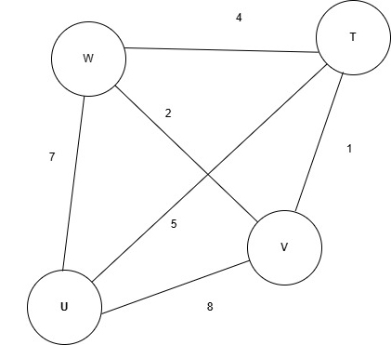
Activity1(20 minutes) Think Pair Share Find MST.

Slide 8
Reflection- Learning Activity 1
Selected Node-→ |  |  | W | V | T | U
Node | Dis Par | Dis Par | Dis Par | Dis Par | Dis Par | Dis Par
U | ∞ Nil | ∞ Nil | 7 W | 7 W | 7 W | 7 W
V | ∞ Nil | ∞ Nil | 2 W | 2 W | 2 W | 2 W
W | ∞ Nil | 0 Nil | 0 Nil | 0 Nil | 0 Nil | 0 Nil
T | ∞ Nil | ∞ Nil | 4 W | 3 V | 3 V | 3 V

Slide 9
Prim’s Algorithm:
PRIM (G, w, r):
1. For each vertex u € V( G ) repeat steps 2 and 3.
2. Do key(u) ←∞
3. Par(u) ←NIL
4. key(r) ←0 and T ← NULL
5. Q ← V[G] Initialize priority queue Q
6. While priority queue Q is not empty repeat steps 7,8 and 9
7 . Do u ← EXTRACT_MIN(Q) AND add to T
8. For each vertex v in Adj[u] repeat step 9
9. if w(u,v) <key( v) and v € Q
then key(v) = w(u,v) and Par(v) ← u
10. Exit

Slide 10
Conclusion: t Students can now:
Apply Prim’s algorithm to find the Minimum Spanning Tree.

Slide 11
Post session activities: MCQ based Quiz on this lesson.

Slide 12
Information about the next lesson: Dijkstra’s Algorithm and analyse its complexity.

Slide 13
Review and Reflection from students

